Slide 1
Town Centre Management in Austria concrete projects and good practice
Roland Murauer
CIMA Austria
4th international SME Conference
Postojna, Slovenia
28th of March 2017

Slide 2
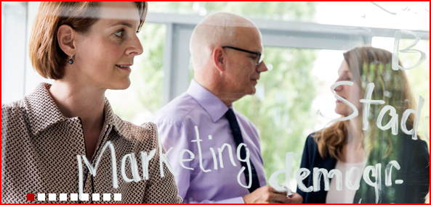
CIMA profile
    Austrian-German consulting agency for urban and regional planning
    6 offices in Germany (Cologne, Hannover, Leipzig, Lübeck, Munich, Stuttgart) and 1 in Austria (Ried)
    100 employees with a broad range of experience and knowledge
    since 1988 more than 3.000 projects in Austria, Belgium, Czech Republic, France, Germany, Hungary, Italy, The Netherlands, Spain, Slovenia, Slovakia, Switzerland
    international network and cooperation with urban developement experts, consulting agencies and universities in Europa, USA and Asia
www.cima.co.at
www.cima.de

Slide 3









Town Centre Management in Austria
    first TCM projects in the early 1990s
    currently 110 professional TCM units (200 cities in Austria)
    nearly all of the TCMs are public-private-partnership cooperations (municipality, local entrepreneurs association, touristic association)
    60 % of the TCMs organised as limited liability companies
    average work experience of TCM managers – 12 years
    average annual basic budget
      cities up to 20.000 inhabitants 195.000 €
      cities up to 20.000 to 60,000 inhabitants 381,000 €
      cities more than 60,000 inhabitants 782,000 €
    65 % of the activities are focused to increase the attraction of the City Centre
–
–
3

Slide 4
activity fields for TCM in Austria
1
Citymarketing
2
Tourism Marketing
3
Investors Marketing
4
public affairs
5
urban planning and infrastructural affairs
12 main TCM
activity fields
7
qualification and knowledge transfer
6
Cultural Marketing
8
networking
9
Event Marketing
10
special interest management
11
regional marketing
12
internal administrative work
4

Slide 5
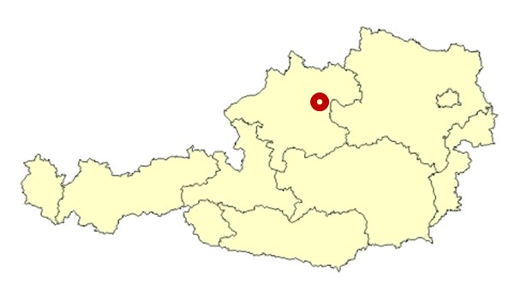

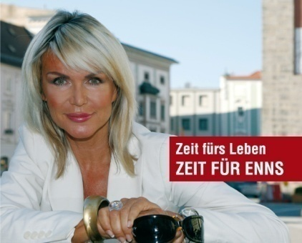

„good practice 1“ – TCM Enns
    1st Austrian „citta slow“ city
    sustainable impact of citta slow branding for City Centre development – settlement of 40 new enterprises
    range of citta slow affine TCM projects
      citta slow gastronomy tour
      citta slow award
      citta slow regional product box
      citta slow farmers market
      citta slow carnival
Enns/Upper Austria
11.000 inhabitants
TCM unit since 2007
180.000 € basic budget
5

Slide 6
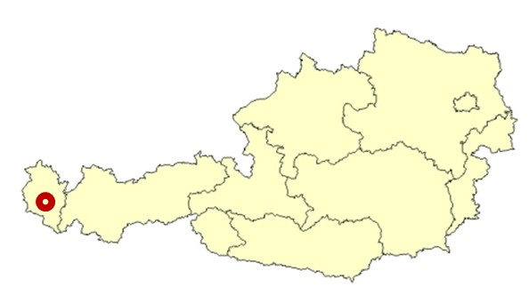


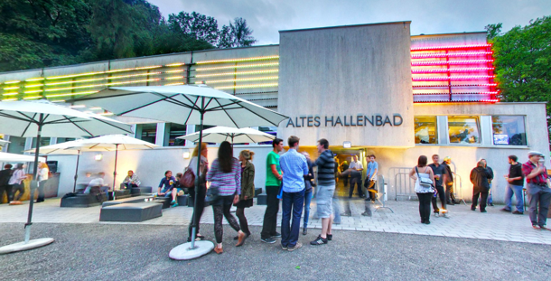
„good practice 2“ – TCM Feldkirch
    „one stop shop“ TCM unit
    core focus on cultural events like the „poolbar“ music and design festival
    TCM unit also responsible for the management of
      (new) congress hall
      municipal camping and caravan ground
Feldkirch/Vorarlberg
38.000 inhabitants
TCM unit since 1999
550.000 € basic budget
6

Slide 7
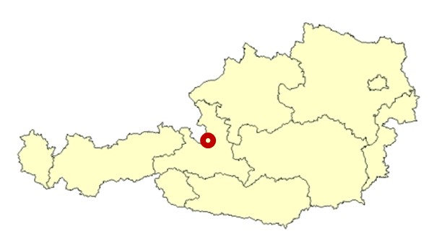




„good practice 3“ – TCM Hallein
    customer service days (60 City Centre enterprises offer a broad range of different services)
    smart and clever construction site marketing campaign during the renovation works in the City Centre
      intensive information campaign
      construction site ambassadors
      distribution of various goodies (roadmen playmobil, marzipan bricks, shoe shine kits)
      construction site festival
Hallein/Salzburg
20.000 inhabitants
TCM unit since 2015
190.000 € basic budget
7

Slide 8



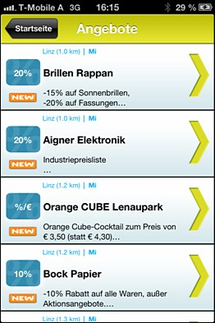
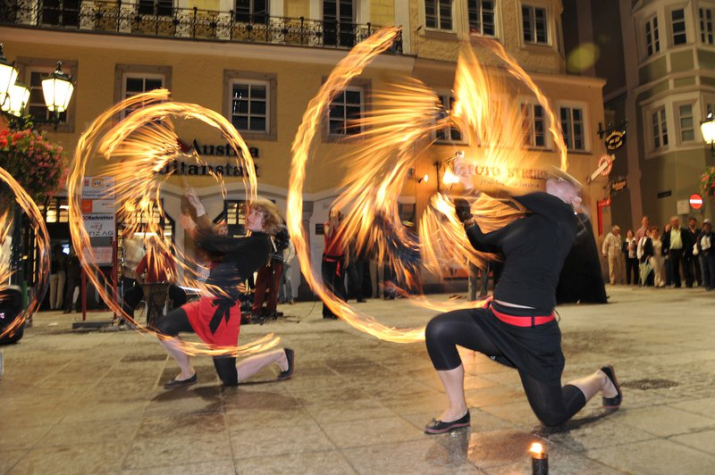
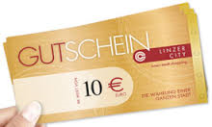
„good practice 4“ – TCM Linz
    TCM unit mainly financed by local retailers
    range of successful TCM projects
      student Wednesday
      culinaric events
      biggest street artist festival
      city voucher (4 Mio € turnover/year)
Linz/Upper Austria
200.000 inhabitants
TCM unit since midst of the 1980s
250.000 € basic budget
8

Slide 9
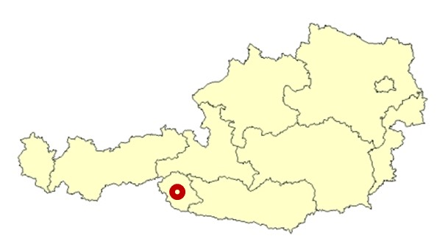

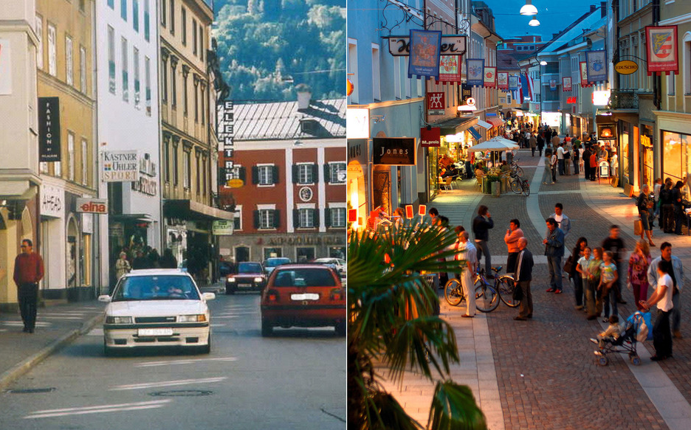
„good practice 5“ – TCM Lienz
    TCM unit as municipality departement
    most successful project
      public-private-partnership aggreement between the municipality and 98 house owners in the City Centre for common investment in street infrastructure, floral decoration, house facades, ….
      3 Mio € investment from the private sector and 3 Mio € investment from the municipality
Lienz/Tyrol
12.000 inhabitants
TCM unit since 1994
180.000 € basic budget
9

Slide 10
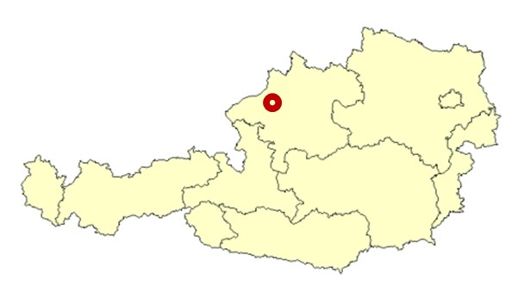

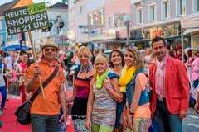
„good practice 6“ – TCM Ried im Innkreis
    one of the first professional TCM units in Austria
    2017 starts two innovative projects
      „stadtup Ried“ – business contest for new enterprise settlements in the City Centre
      „Ried donates joy“ – digital voucher plattform
Ried/Upper Austria
11.000 inhabitants
TCM unit since 1995
680.000 € basic budget
10

Slide 11

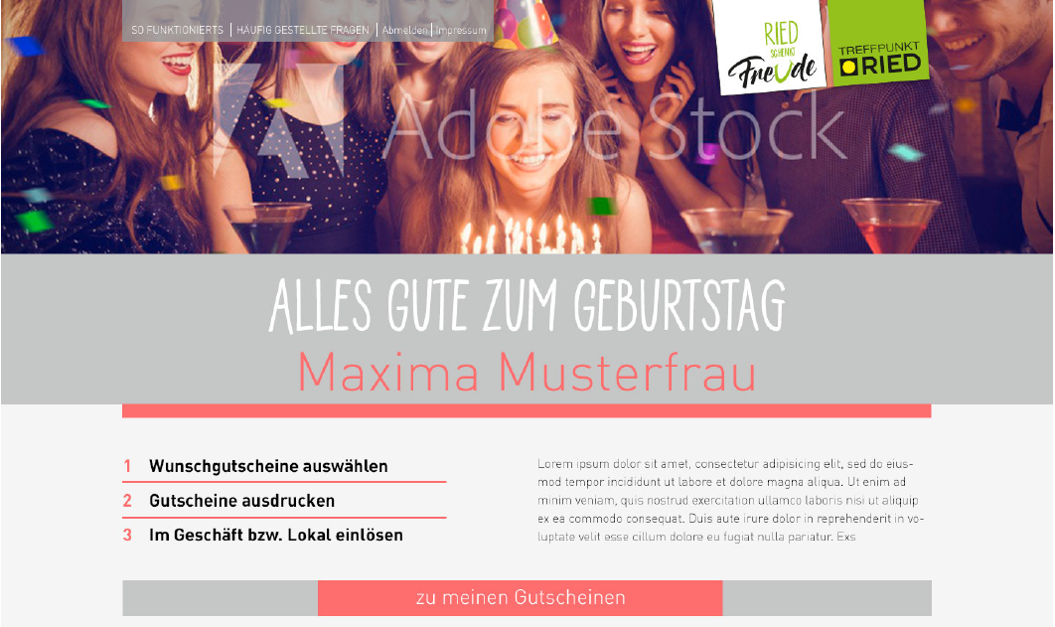
„good practice 6“ – TCM Ried im Innkreis
11

Slide 12
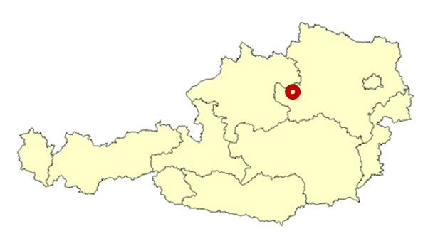
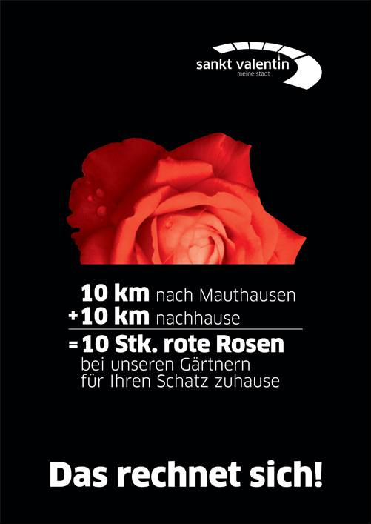
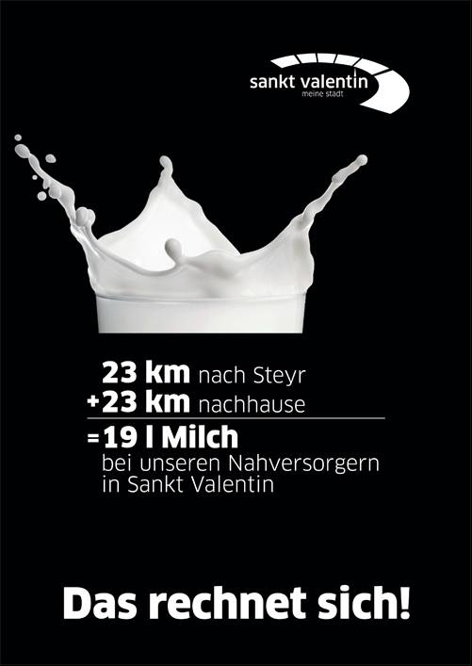
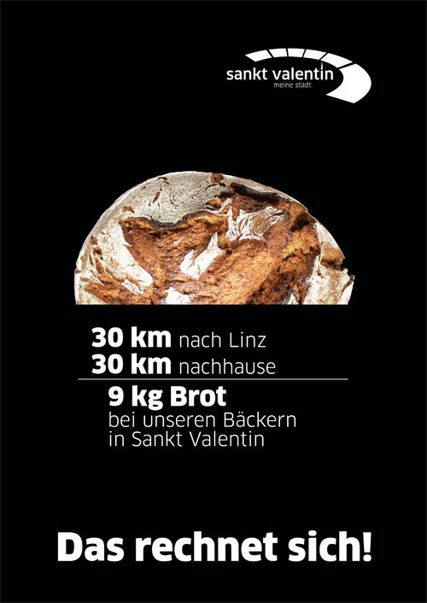

„good practice 7“ – TCM Sankt Valentin
    local customer information campaign in a new and smart way
St. Valentin/Lower Austria
10.000 inhabitants
TCM unit since 2009
160.000 € basic budget
12

Slide 13
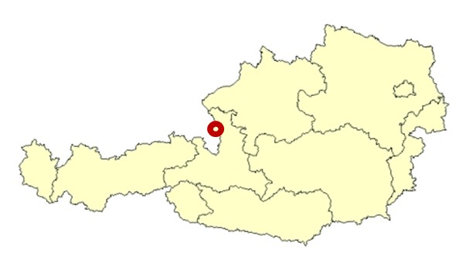

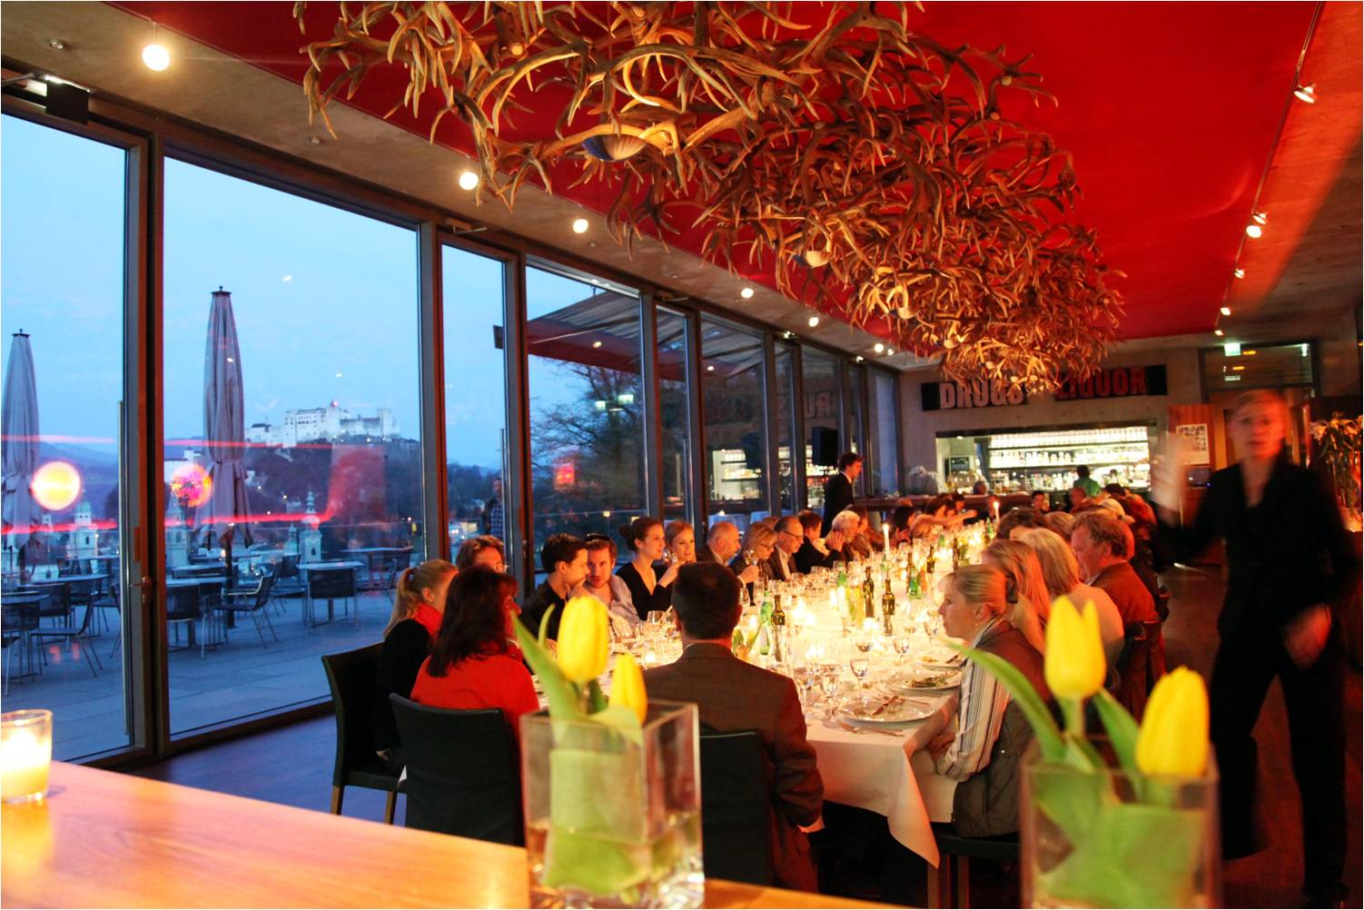


„good practice 8“ – TCM old quarter of Salzburg
    TCM unit for the old quarter of Salzburg
    two outstanding events
      „eat & meet“ – culinary & art events in the gastronomy of Salzburg
      Jazz & The City – music festival
City of Salzburg
150.000 inhabitants
TCM unit since 2000
1,6 Mio € basic budget
13

Slide 14
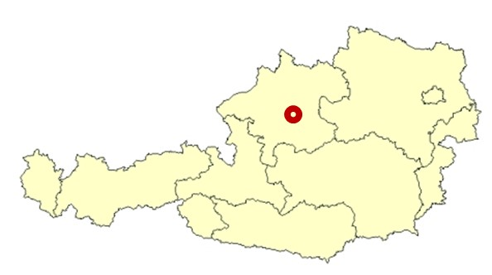


„good practice 9“ – TCM Schwanenstadt
    one core focus of TCM Schwanenstadt – qualification programm (6 moduls) for City Centre employees
Schwanenstadt/Upper Austria
5.000 inhabitants
TCM unit since 2005
90.000 € basic budget
14

Slide 15
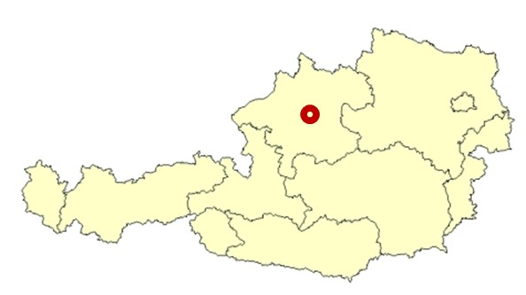
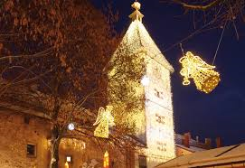

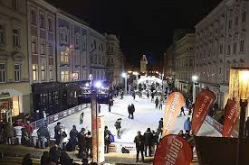

„good practice 10“ – TCM Wels
    very powerful TCM and tourism marketing unit
    2011 – development of the „Welser Christmas world“ – new model of christmas market with an huge ice rink in the heart of the City Centre
Wels/Upper Austria
60.000 inhabitants
TCM unit since 1994
1,1 Mio € basic budget
15

Slide 16

Last but not least a general advice
for all TCM managers
A good hockey player plays
where the puck is.
A great hockey player plays
where the puck is going to be !!
Wayne Gretzky
16

Slide 17
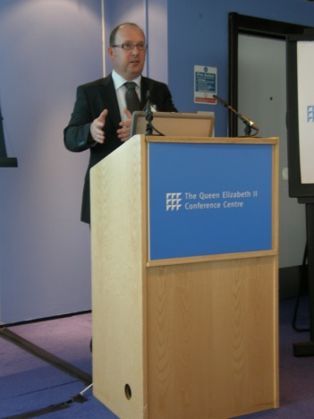
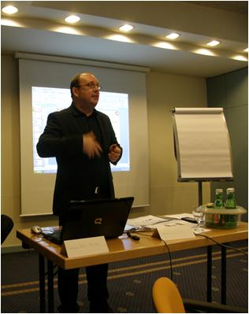
CV – Roland Murauer
    50 years
    study of general business administration at the Johannes-Kepler University in Linz (A)
    job experience since 27 years in the field of urban and regional planning
    since 1993 – CEO of CIMA Austria
    up to know – responsible for 350 urban and regional developement projects, retail trade analysis, tourism and property management projects in Austria, Czech Republic, Germany, Hungary, Italy, Slovenia, Slovakia, Switzerland, .....
    board member of the Austrian TCM association
    lector at the Danube University of Krems
contact address
CIMA Austria
A-4910 Ried
Johannesgasse 8
phone
0043 7752 71117
email
cima@cima.co.at
www.cima.co.at
17

